Slide 1
Object Oriented Programming
Indra Azimi, S.T., M.T.
D3 Teknik Informatika, Telkom University

Slide 2
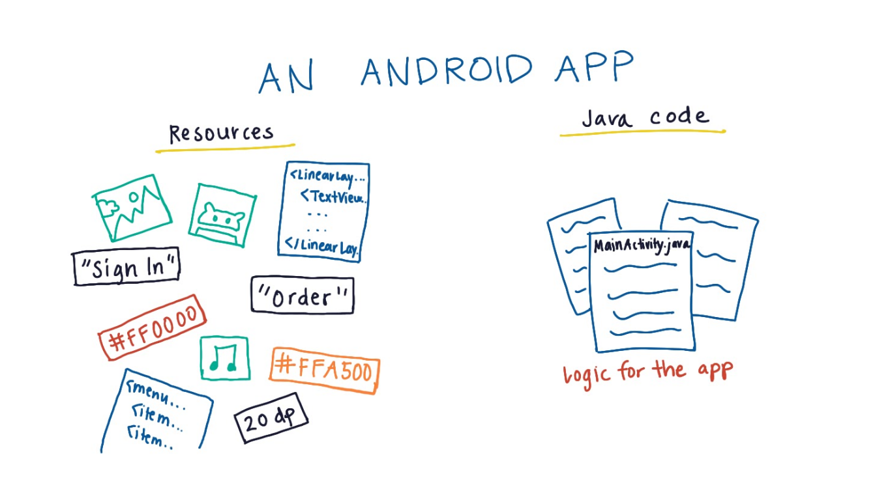
Components of an Android App

Slide 3
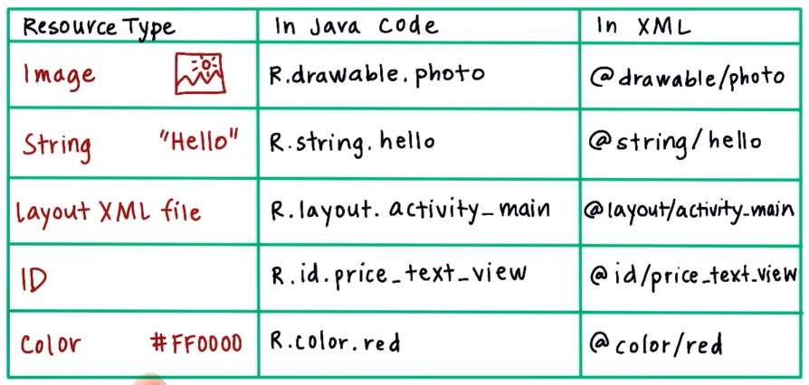
Resources

Slide 4
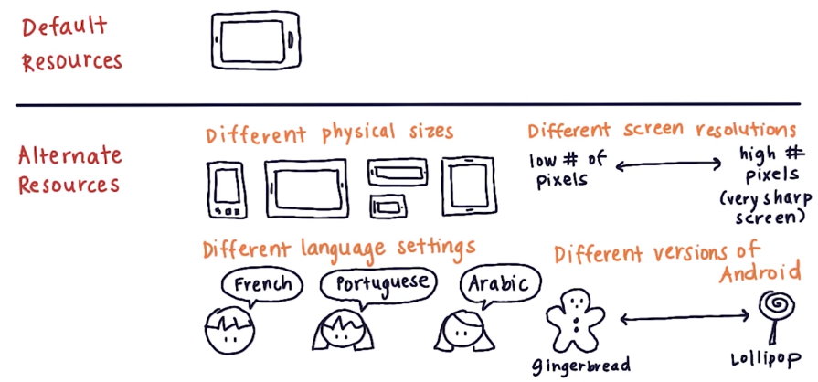
Provide Resources

Slide 5
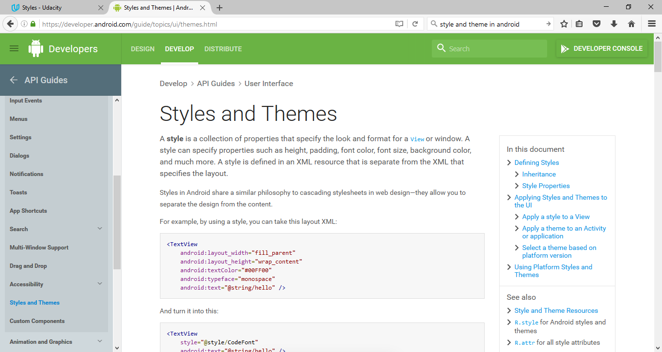
Styles and Themes
https://developer.android.com/guide/topics/ui/themes.html

Slide 6
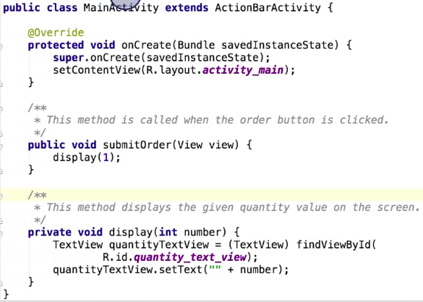
Java Code

Slide 7
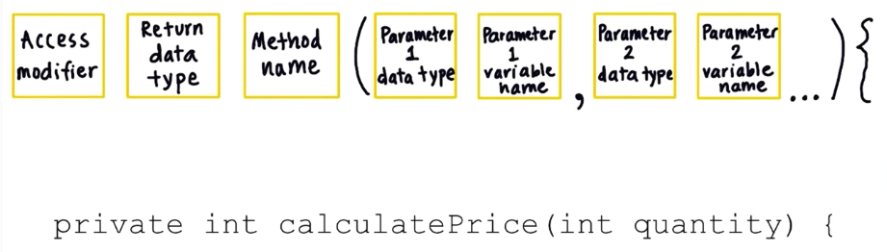
Define a Method

Slide 8
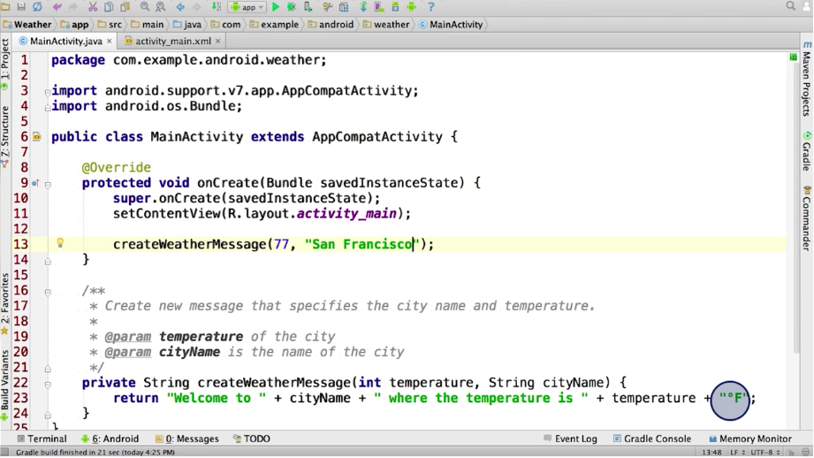

Slide 9
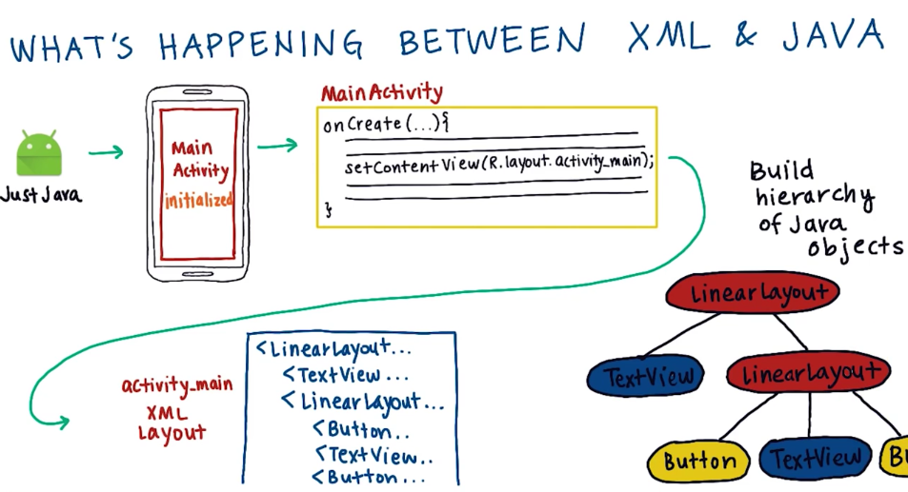

Slide 10
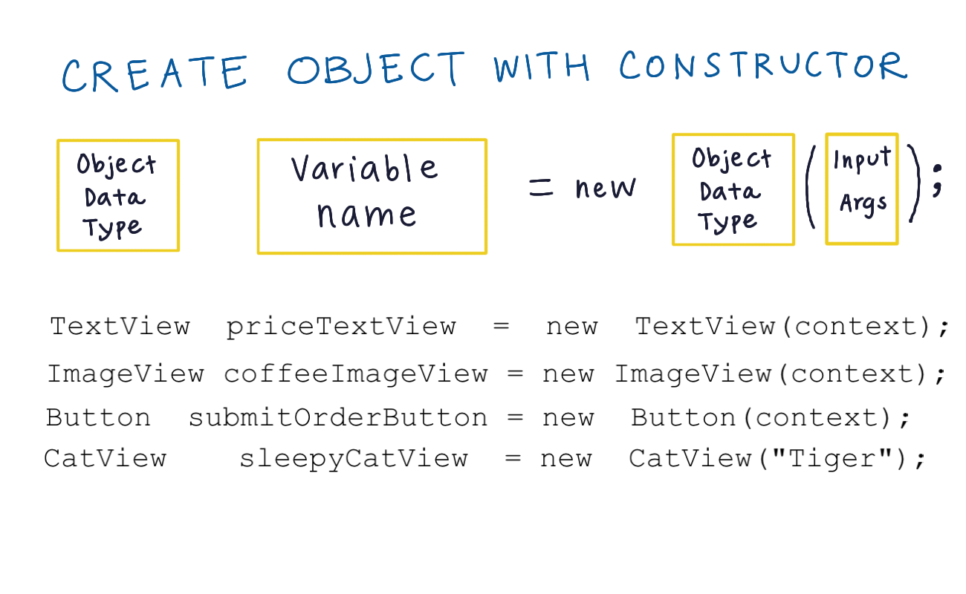

Slide 11
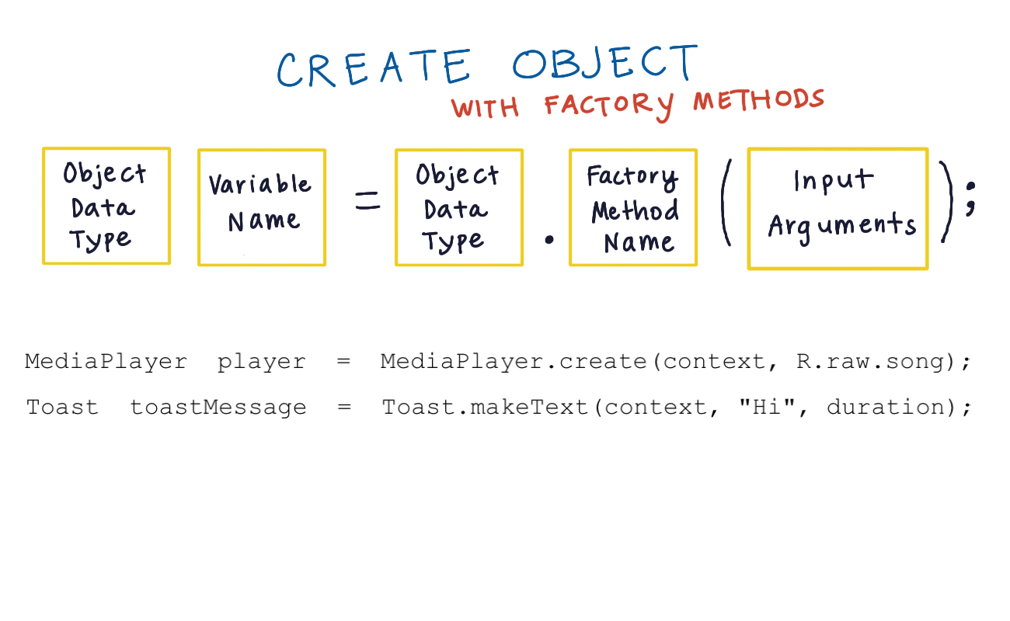

Slide 12
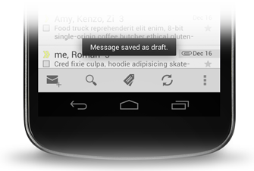
Toast

Slide 13
Toast
Toast.makeText(context, text, duration).show();
“Message saved as draft."
this
Toast.LENGTH_SHORT
https://developer.android.com/guide/topics/ui/notifiers/toasts.html

Slide 14
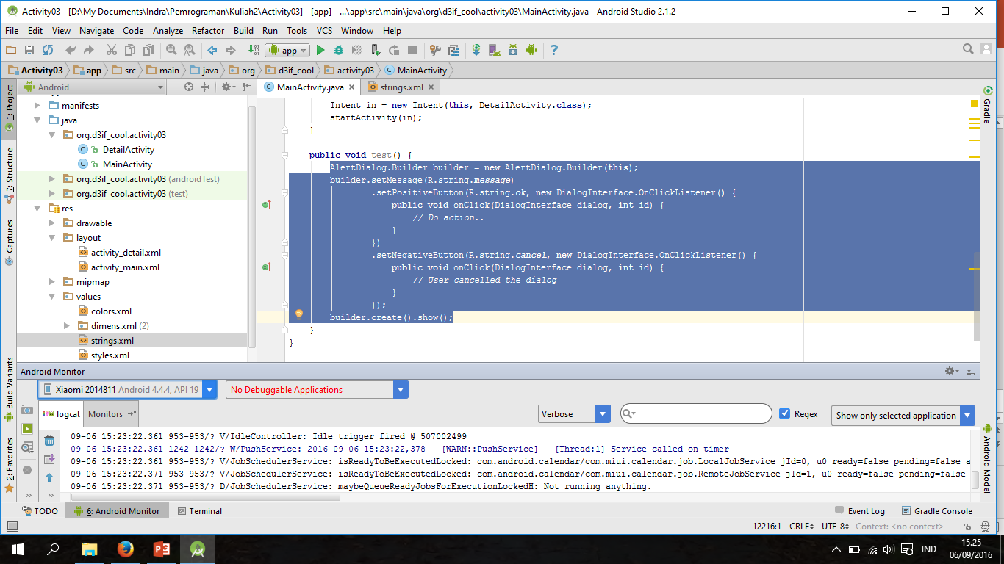
Log
Log.v(“IdleController", “Idle trigger fired @ " + i);
https://developer.android.com/reference/android/util/Log.html

Slide 15
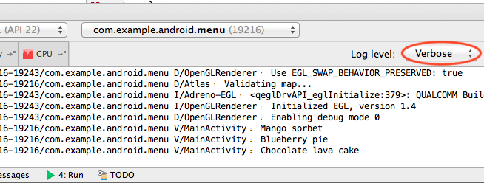
Log
The order in terms of verbosity, from least to most is ERROR, WARN, INFO, DEBUG, VERBOSE.

Slide 16
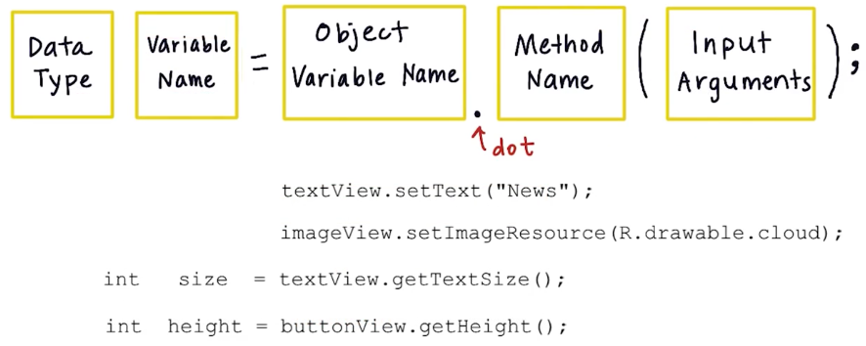
Call method on object

Slide 17
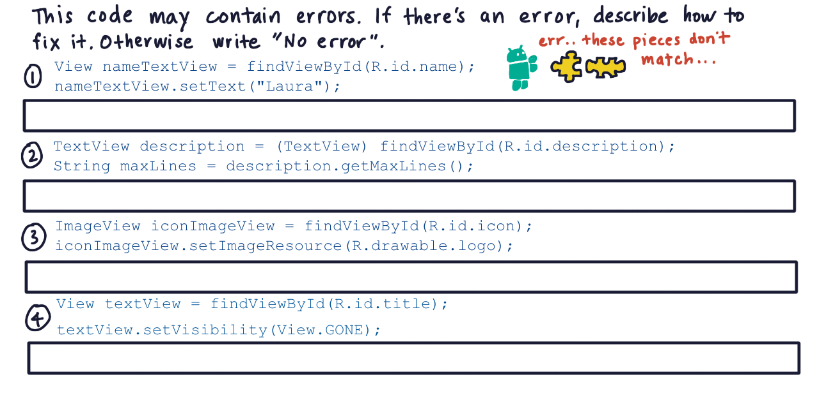
Data Type Mismatch

Slide 18
Common Android Views
https://drive.google.com/file/d/0B5XIkMkayHgRMVljUVIyZzNmQUU/view

Slide 19
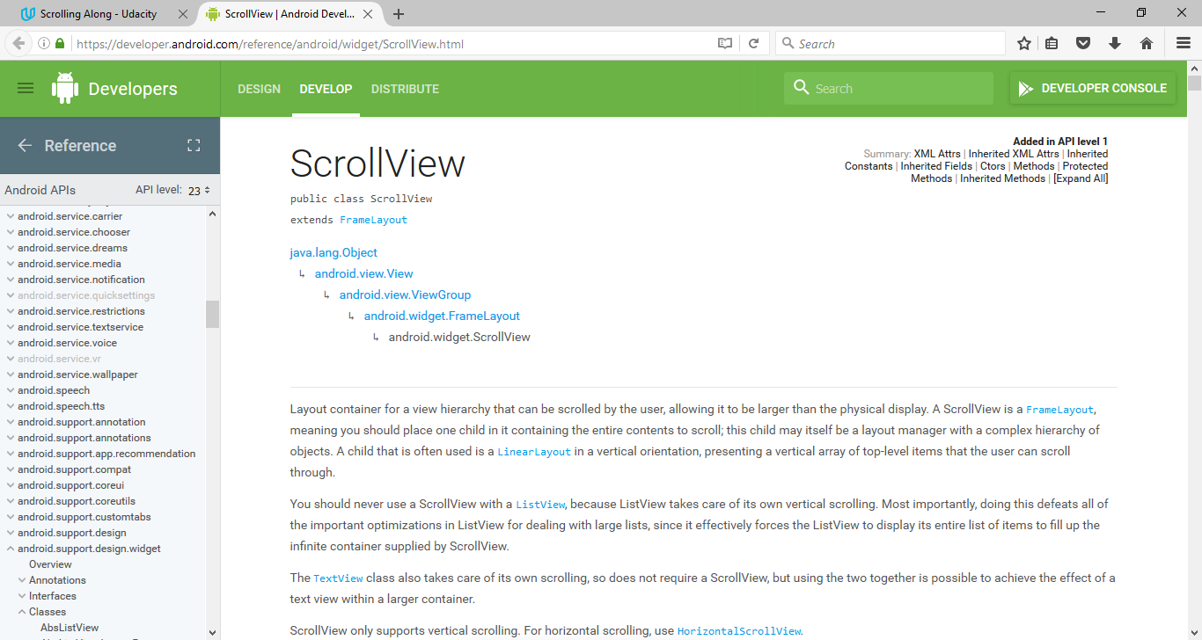
Scrolling Along
https://developer.android.com/reference/android/widget/ScrollView.html

Slide 20
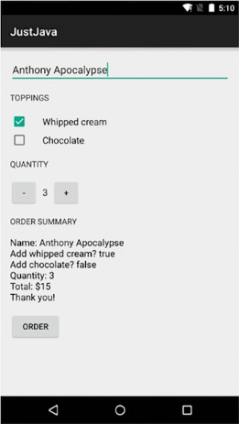
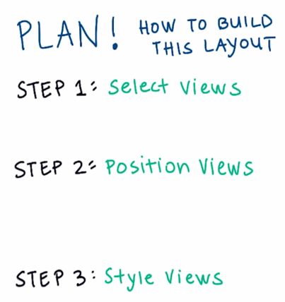
Just java
Aplikasi untuk memesan kopi yang terintegrasi dengan aplikasi email.

Slide 21
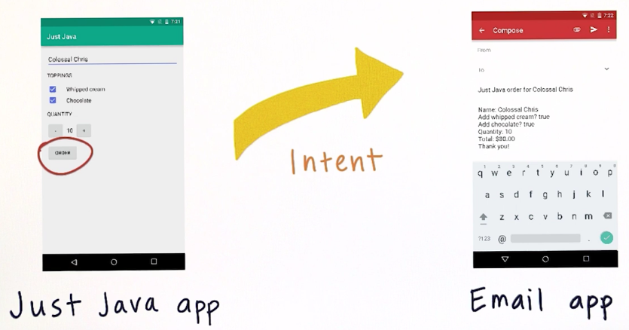
Sending Intents

Slide 22
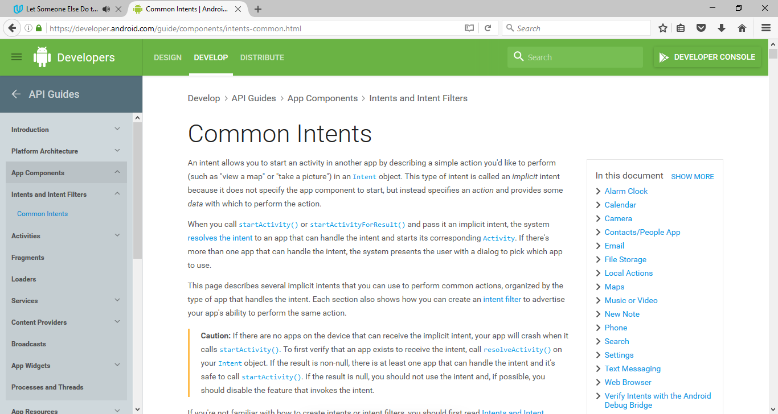
Common Intents
https://developer.android.com/guide/components/intents-common.html

Slide 23
Referensi
Lesson 3A – 3B: Object Oriented Programming
Android Development for Beginners
https://www.udacity.com/course/ud837

