Slide 1
Building layouts
Indra Azimi, S.T., M.T.
D3 Teknik Informatika, Telkom University

Slide 2
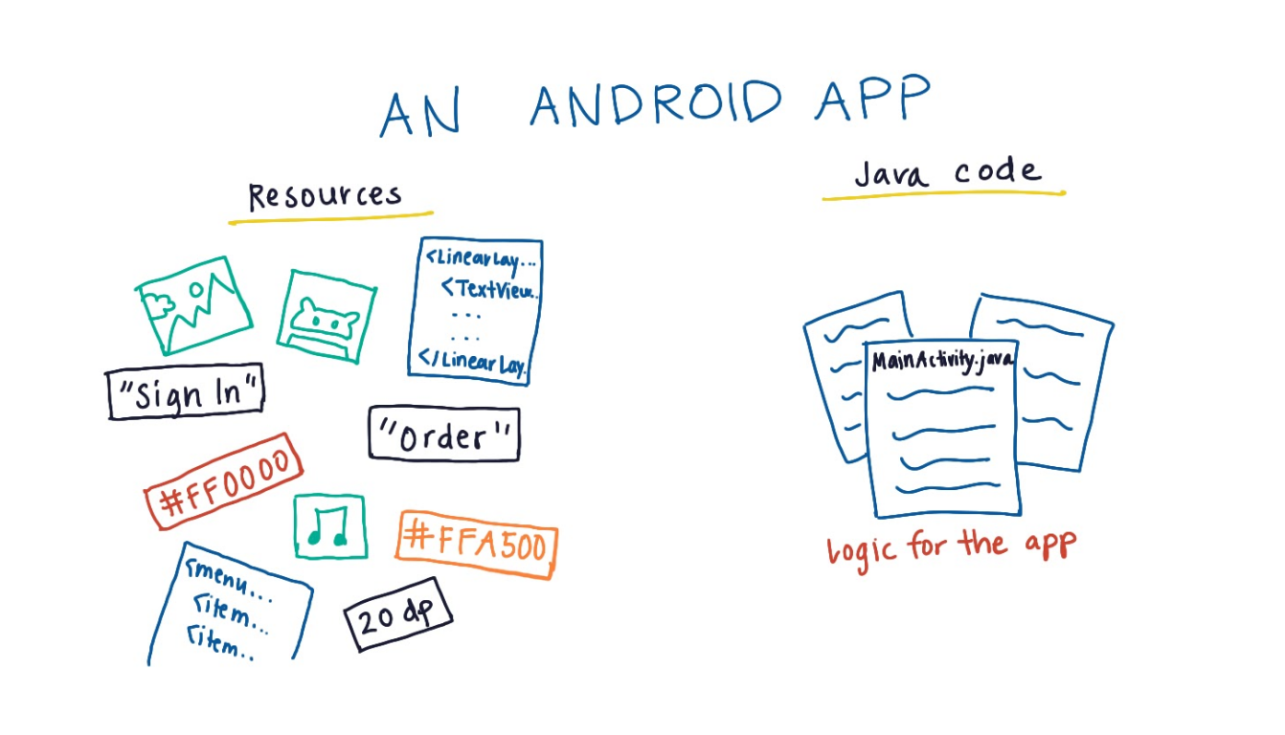
Components of an Android App

Slide 3
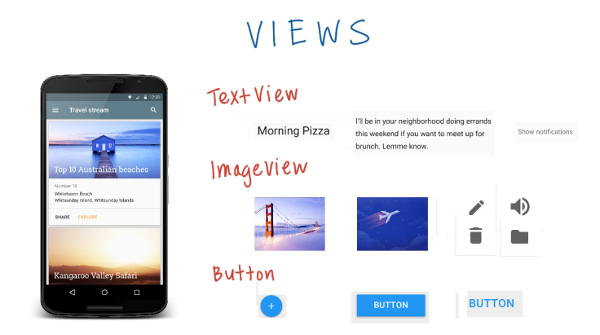
Views
CamelCase

Slide 4
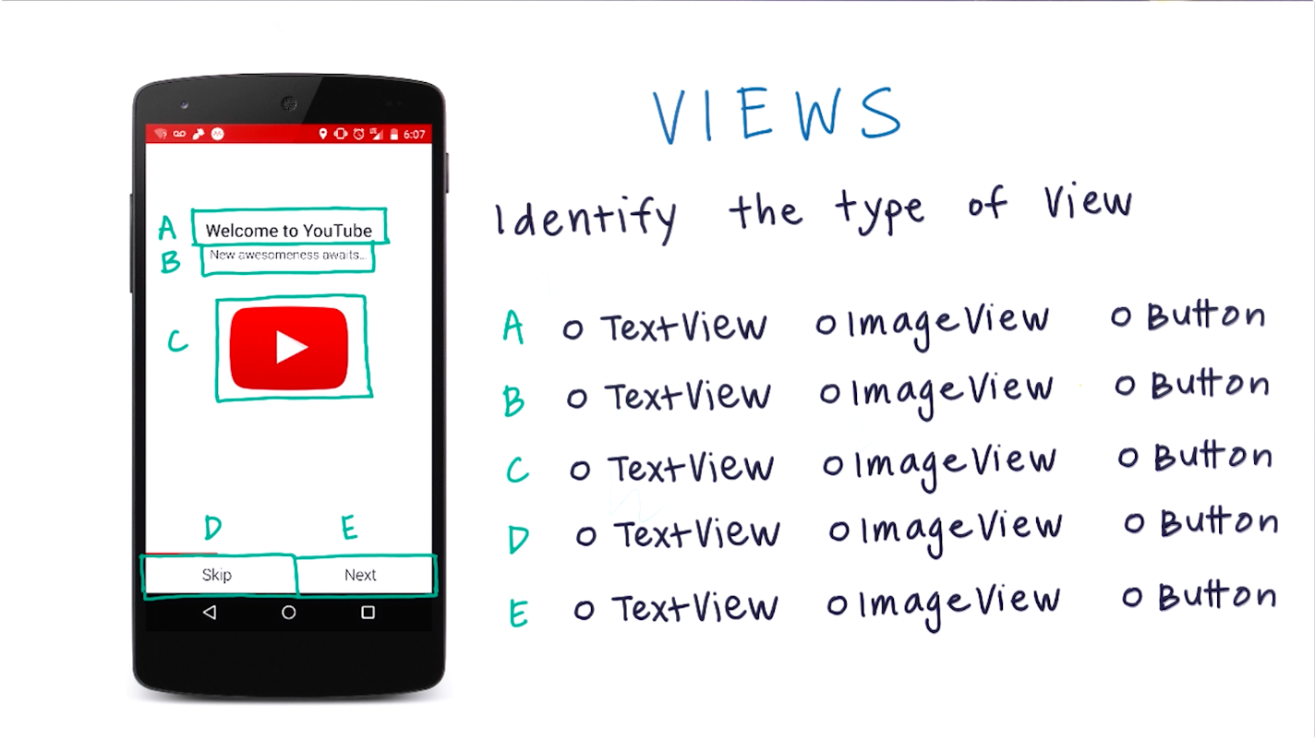

Slide 5
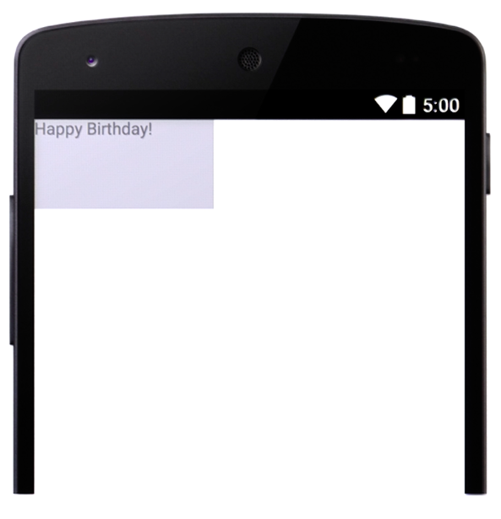
TextView

Slide 6
Xml Syntax

Slide 7
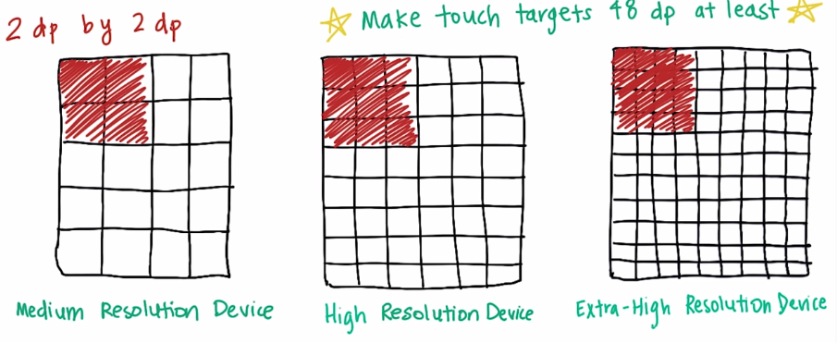
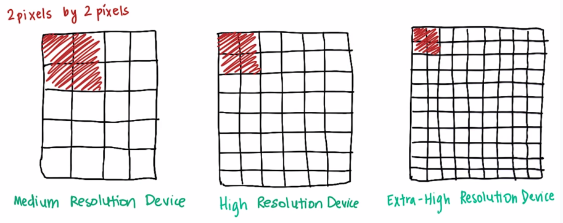
Why DP? Density-Independent pixels

Slide 8
Another textview
Color in
HEX code
What’s this?
Why SP?

Slide 9
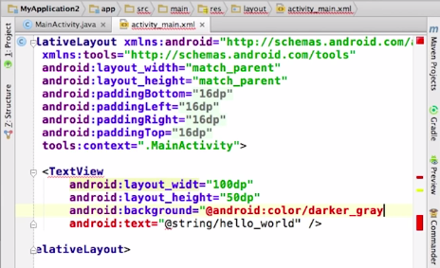
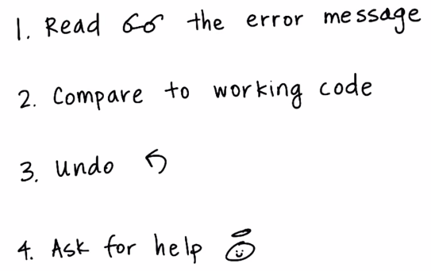
Getting past Errors

Slide 10
Getting past Errors
Line 1: Tag `Text` is not a supported opening tag.
The attribute android:layout_height does not support the value 150 (Line 4)
The computer wasn't able to understand your XML. (If any of your code is colored red, the error might be just before it.)

Slide 11
ImageView
src → sets a drawable as the content of this ImageView.
scaleType → controls how the image should be resized or moved to match the size of this ImageView.

Slide 12
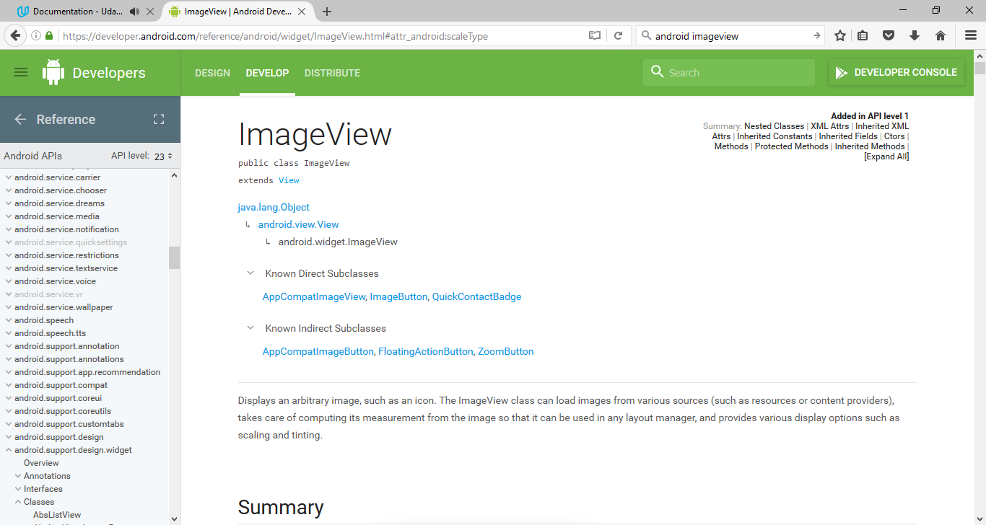
Android Documentation
https://developer.android.com/reference/android/widget/ImageView.html

Slide 13
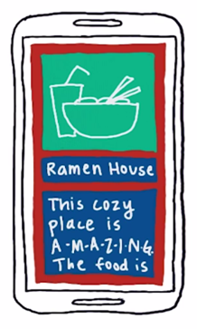
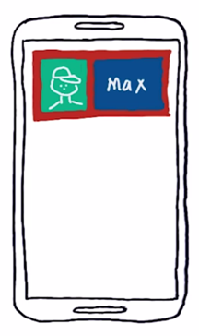
ViewGroups
LinearLayout
(vertical)
LinearLayout
(horizontal*)
RelativeLayout

Slide 14
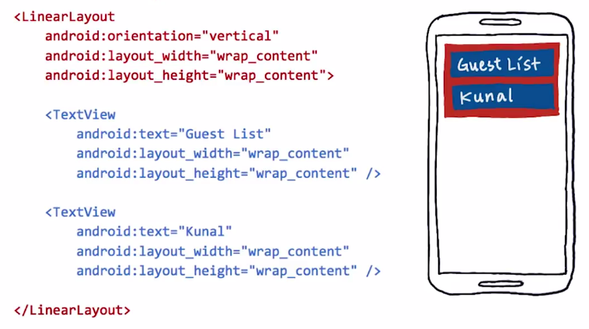
LinearLayout

Slide 15
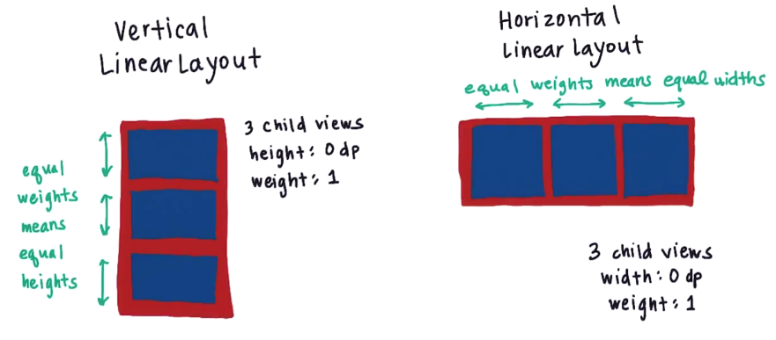
LinearLayout Evenly Spacing out children

Slide 16
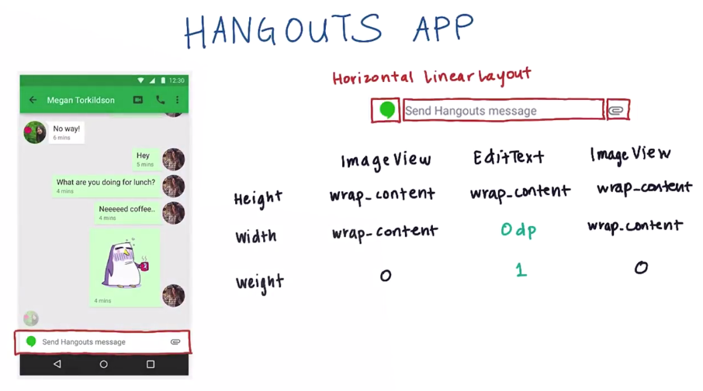
?

Slide 17
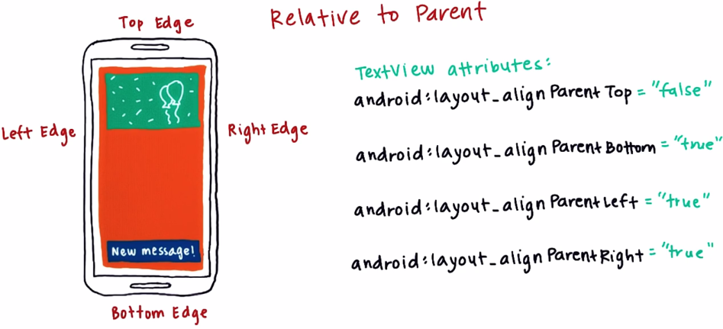
Relativelayout

Slide 18
Relativelayout

Slide 19
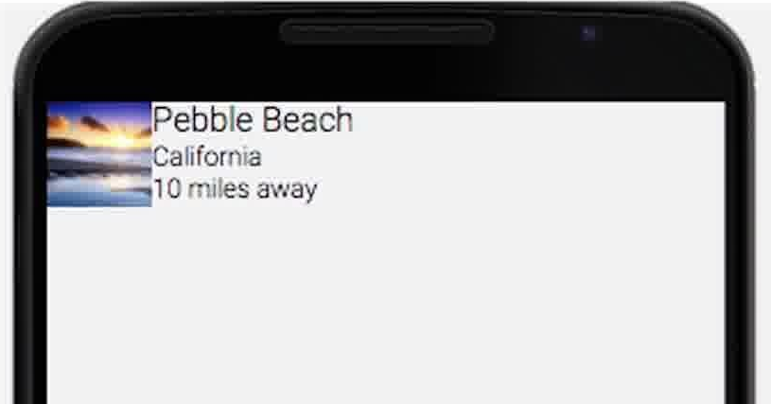
How to achieve this?

Slide 20
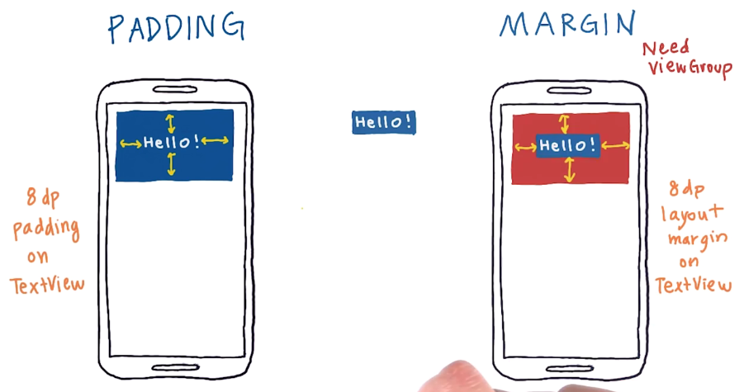
Padding vs Margin

Slide 21
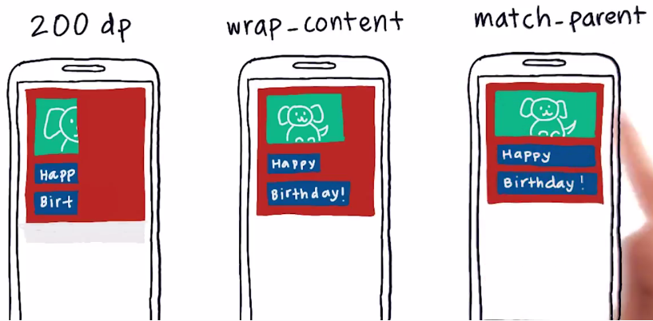
Different widths on child views

Slide 22
Useful Links
Vocab Glossary https://developers.google.com/android/for-all/vocab-words/?hl=en
Cheat Sheet https://drive.google.com/file/d/0B5XIkMkayHgRMVljUVIyZzNmQUU/view
Material design: Typography https://material.io/guidelines/style/typography.html#typography-styles
Material design: Color https://material.io/guidelines/style/color.html#color-color-palette

Slide 23
Referensi
Lesson 1A – 1B: Building Layouts
Android Development for Beginners
https://www.udacity.com/course/ud837

