Slide 1
Literasi TIK Critical Information Evaluation and Search Process
Shinta Yulia P
Semester Ganjil – TA 2016/2017

Slide 2
Discussion:
1. Information Evaluation
2. Information Search Process
Tujuan Pembelajaran :
Mampu lebih kritis dan memahami proses untuk evaluasi informasi
Memahami karakteristik dalam mengevaluasi informasi
Memahami proses pencarian informasi

Slide 3
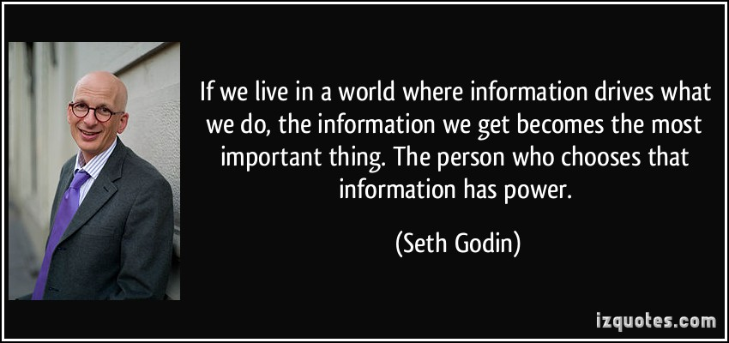

Slide 4
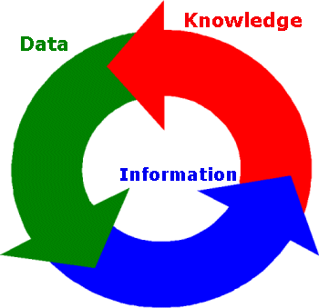
What is Information?

Slide 5
INFORMATION EVALUATION
Now a days, information is spread around us and easily obtained through a search on the Internet, at the library even through social media and chat groups that we follow.
Information not only easier to find, but there is a lot more of it.
However, not all the information available it is VALID, USEFUL, or ACCURATE.
Here is the importance of evaluating the (source) information.
Evaluate resources is an important skill for searching, sorting, and decide which information should be received.
Question
When somebody do research on a specific topic, how to find the right information to support such research?

Slide 6
CHARACTERISTICS TO CONSIDER WHEN EVALUATING INFORMATION SOURCES
Authority
Timeliness
Relevancy
Quality
Perspective

Slide 7
Authority
One alternate to tell whether a content writing is valid or not, is to know the credentials of the author, such as educational background, field of work, and membership organizations that followed (affiliates). Writer with high education degree or has a lot of published books or articles tend to be more credible. Ex: http://wp.comminfo.rutgers.edu/ckuhlthau/
The number and types of literature (interest) have been made previously. Use a search engine or a citation index to track how often articles or writings ever made, was quoted by others in related fields. Ex: http://tylertate.com/; GoogleSchoolar (https://scholar.google.co.id)
Find out also the profile of the website, publisher or organization that published articles and books.
Sources who come from the universities, professional societies, scientific publishers, or a scientific journal has had a peer-review process and rigorous editing. So it can be used as a reliable source.

Slide 8
Authority
What are the credentials and affiliation or sponsorship of any named individuals or organizations?
How objective, reliable, and authoritative are they?
Have they written other articles or books?
Is the author(s) listed with contact information (street address, e-mail)?
Has the publisher published other works?
Do they specialize in publishing certain topics or fields?
Is the publisher scholarly (university press, scholarly associations)? Commercial? Government agency? Self (“vanity”) press?

Slide 9
Timeliness
When in need of information that was updated, make sure the date of publication.
If using a text book, check and use the latest edition if any.
Newly published sources tend to be more trustworthy than the older source
For some cases older sources, can continue to be used until a few years into the future
Publication date is generally located on the title page or on the reverse side of the title page (copyright date).
Is the information provided by the source in its original form or has it been revised to reflect changes in knowledge?
Is this information timely and is it updated regularly?

Slide 10
Relevancy
Make sure the content in accordance with the purpose
What is implied by the content?
Are diverse perspectives represented?
Is the content relevant to your information needs?

Slide 11
Quality
Check grammar, spelling, and punctuation!
Check if the information is arranged and have a clear path and structured!
Check if the information authentic!
Check if the information unique or has it been copied!

Slide 12
Bias
Writing purpose. Is anything being sold?
Are any conclusions offered? If so, based on what evidence and supported by what primary and secondary documentation?
Are the author’s arguments and conclusions are supported by credible and cited sources. Ex: https://astridsila.wordpress.com/annotated-bibliography/
Read the source’s introduction and conclusion. Is it opposing viewpoints are acknowledged or addressed?
Look for sources with authors who appear to have considered various perspectives as opposed to biased sources that present evidence only supporting one side
If the source represents only one view, you will want to read additional sources that represent and provide evidence for other perspectives

Slide 13
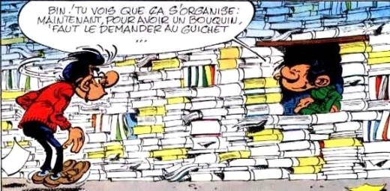
Information Search Process

Slide 15
Definition
The information process is the series of physical and intellectual steps that anyone takes to complete an information task. Each step usually requires the use of several information skills. This process is generally a part of learning and problem-solving
In this slide, we will explain only Big 6
Please read other techniques by yourself

Slide 16
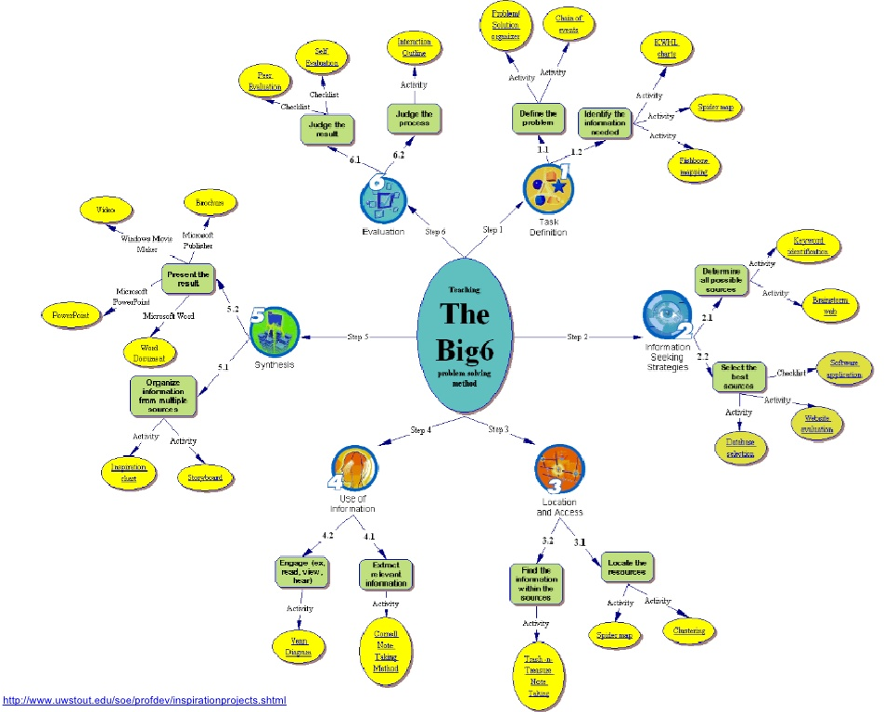

Slide 17
PLAN
DO
REVIEW

Slide 18
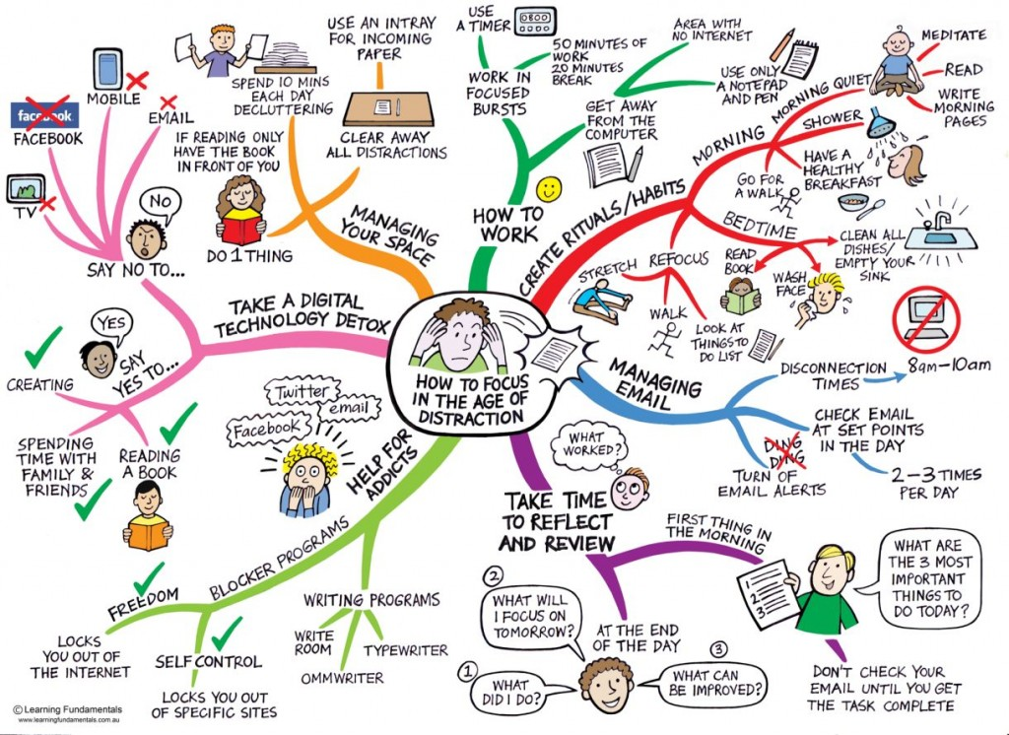
Mind Map / BrainStorming

Slide 19
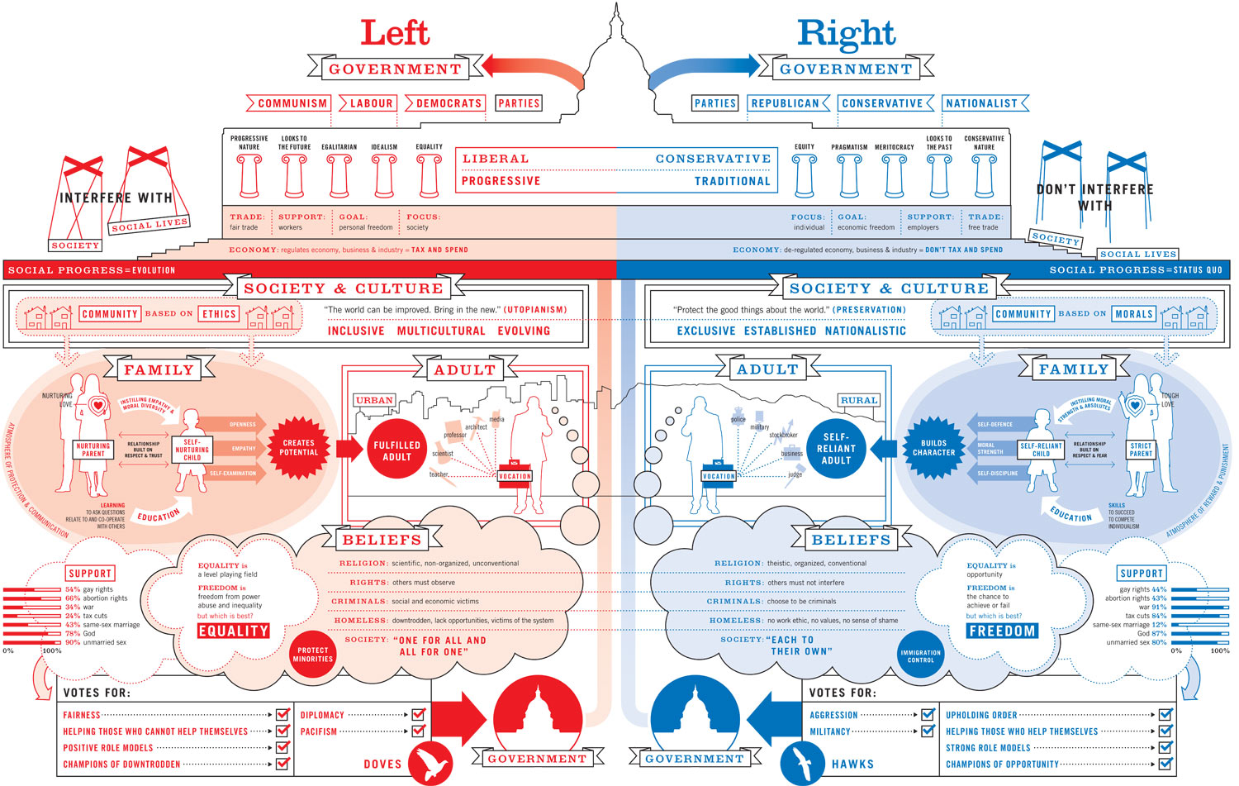
Information Presentation

Slide 20
How to Find Information?
Methods
Kuhlthaus
Flip It!
Alberta Inquiry
Big 6

Slide 24
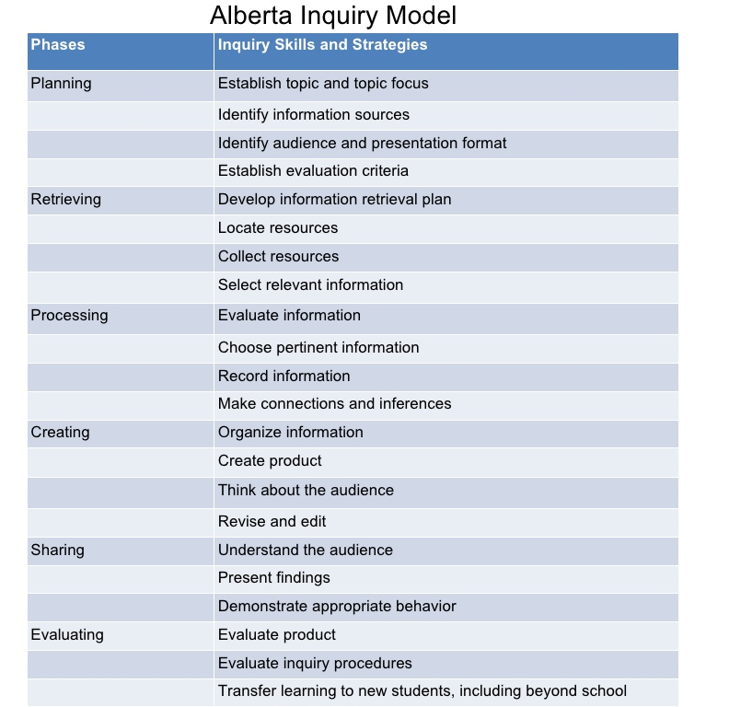

Slide 25
Latihan
Carilah informasi dan issue terkait suatu pemilu (bisa nasional atau internasional), kemudian analisis dan evaluasi informasi yang didapatkan menggunakan kriteria-kriteria dalam slide ini!

Slide 26
Referensi
(UF|IFAS. University of Florida)
http://library.sdsu.edu/research-services/research-help/evaluating-information
faculty.washington.edu/harryb/courses/INFO310/Kuhlthau.pdf
http://www.nthsyddem-p.schools.nsw.edu.au/curriculum-activities/library/information-process
Wendy Stephens, Library Research Models MCLA, 11 September 2009. http://www.slideshare.net/wsstephens/research-models-2468205
Information design. https://jameskennedymonash.files.wordpress.com/2013/01/information-is-beautiful-001.jpg

